Slide 1
Empowering Communication: AI for Autism and Borderline Autism
Seamless Communication with Context-Aware AI using RoBERTa
Team Name: Segmentation fault

Slide 2
Problem Statement
Autistic individuals often struggle with nuances in text-based communication, such as tone, intent, and emotional context, leading to misunderstandings. This tool aims to provide real-time insights like emotion detection, intent clarification, and simplified explanations to help them communicate more confidently and effectively.

Slide 3
Challenges in Communication
People with autism or borderline autism face difficulties interpreting emotions and context in text.
Misinterpretations can lead to anxiety and miscommunication.
A tool is needed to bridge the gap and improve clarity and understanding in communication.

Slide 4
Our Goal
Build an AI-powered platform using RoBERTa to:
Analyze context and sentiment of messages.
Provide clear and simplified rephrased text.
Enable anxiety-free and meaningful communication.

Slide 5
Core Features
Sentiment Analysis: Understands tone (e.g., happy, frustrated, neutral).
Context Understanding: Detects intent to avoid miscommunication.
Text Reformation: Rephrases text for clarity and simplicity.
Personalized Suggestions: Offers tailored responses.

Slide 6
How It Works
1. User sends a message.
2. RoBERTa analyzes context and sentiment.
3. AI reformulates text for better understanding.
4. Receiver gets context-enhanced message.
5. Suggestions are provided for crafting replies.

Slide 7
Benefits
- Enhances confidence in communication.
- Reduces anxiety and misunderstandings.
- Promotes inclusivity and accessibility.
- Improves relationships and social interactions.

Slide 8
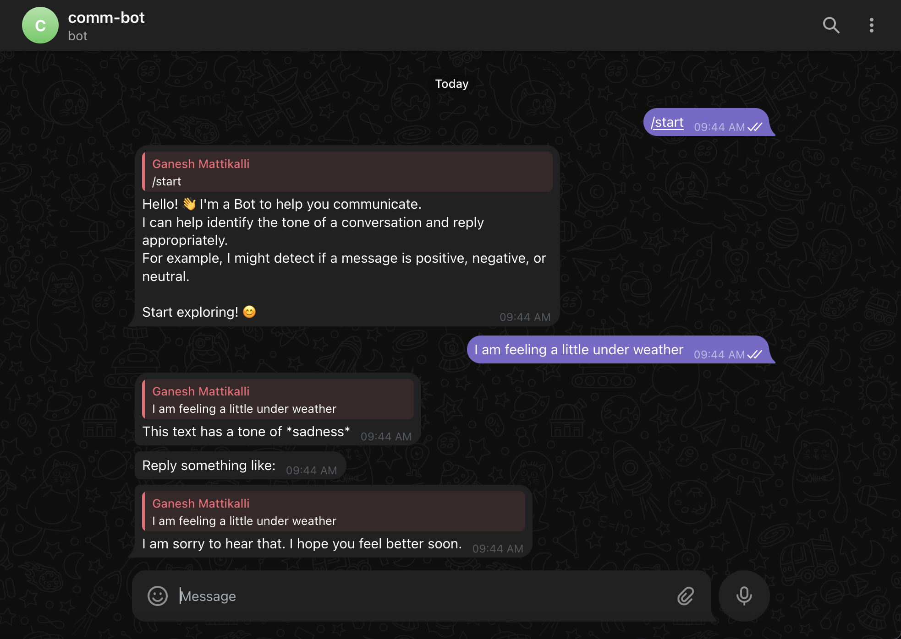
Results

Slide 9

Results

Slide 10
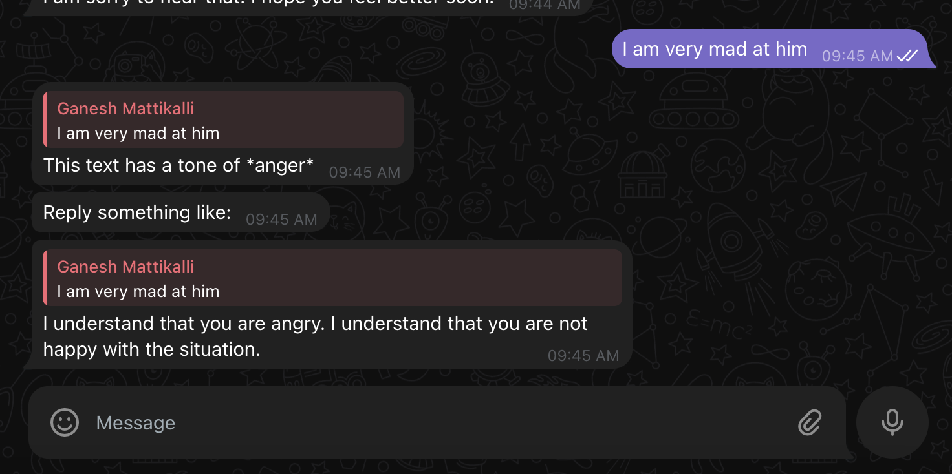
Results

Slide 11
Conclusion
RoBERTa-powered platform empowers seamless communication.
Bridges the gap for neurodiverse individuals.
Let’s innovate for a more inclusive future.

